Slide 1

Timespan Fact Tables
By Tino Zishiri
Saturday 23/03/2024

Slide 2
Agenda
Introduction
Accepted Approach (Periodic Snapshot)
Alternative Approach (Timespan Fact Table)
Worked Example
Closing Remarks

Slide 3




About Me
Tino (Tinomuwonga) Zishiri
Data Analytics Consultant - Adatis (since 2019)
Working with the Microsoft Data stack (since 2017)
May spontaneously bust into song and dance
Notes:
- (Using SQL Server 2005)
- Game: If Everyone Was Forced To Wear A Warning Label… What Would Yours Be?
- try to not sing or dance
- perhaps a standing ovation

Slide 4


Introduction
Storing History in Fact Tables
Illustration: account balance over a 5-day period
AVG
MAX
MIN
Mon
£50
Tue
£50
Wed
£100
Thu
£100
Fri
£190
£98
£190
£50
+
0
+ 50
+ 0
+
90
Transaction Fact Table
I burn and rebuild transaction fact tables for a living.
Notes:
Illustration: The following is an example of the account balance for customer X. The account transactions are tracked throughout the week, starting on Monday with periods of no activity on Monday & Wednesday. On Friday, we can’t merely add up the daily balances during the week and declare that the ending balance is £490. The most helpful way to combine account balances across dates is to average them, which results in an average daily balance of £98.
Storing History in Fact Table (Semi Additive measures)
Aggregation methods: Although we cannot sum up semi additive measures across time. There are other aggregation methods available
Average
Max
Min
Current View
Often a Fact Table will store transaction-level data for a given day using a truncate and reload pattern. The above illustration would result in at most 1 row within said Fact Table.
History
However, end users often require history tracking within a fact table to cater for the following reporting date scenarios.
As of (reporting date)
From a date to a date
Changes between days
Sage advice: Proverbial parachuting person. Ignore him at your peril
FIRE HARZARD!!!

Slide 5

Accepted Approach
Periodic Snapshot Illustration
t₁
t₂
t₃
t₄
Take a picture, it will last longer.
Notes:
Does this remind anyone of their childhood?

Slide 6
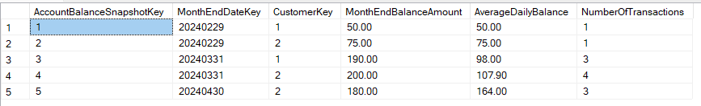
Accepted Approach continued
Periodic (Monthly) Snapshot

Slide 7
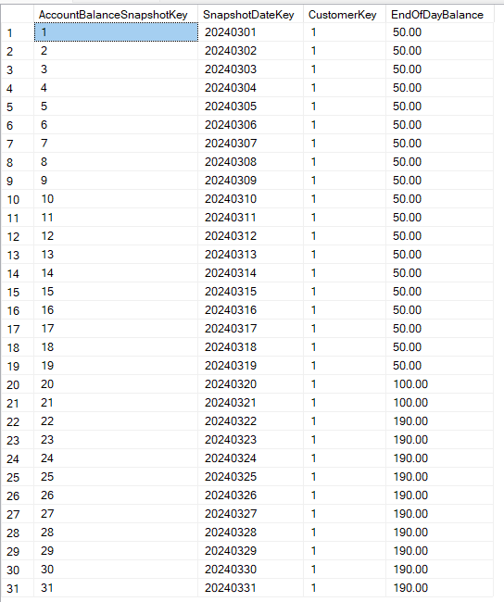
Accepted Approach continued
Periodic (Daily) Snapshot

Slide 8

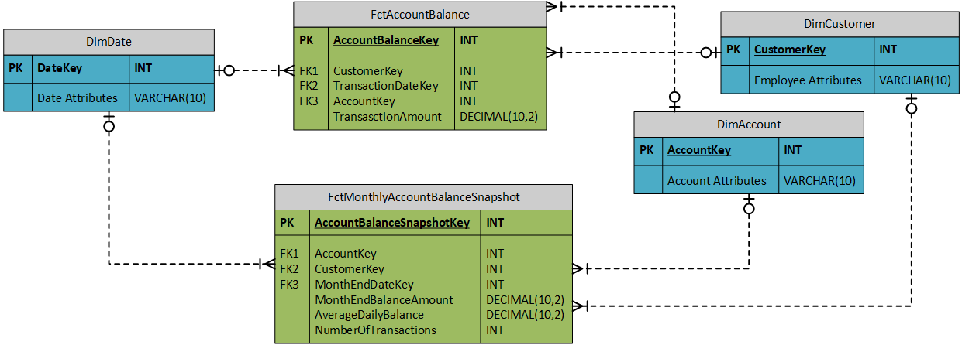

Accepted Approach continued
Periodic Snapshot: Logical Data Model
Notes:
Traditionally, periodic snapshots have been loaded en masse at the end of the appropriate period.
https://learning.oreilly.com/library/view/the-data-warehouse/9781118530801/9781118530801c19.xhtml
Periodic Snapshot Fact Table Loader

Slide 9
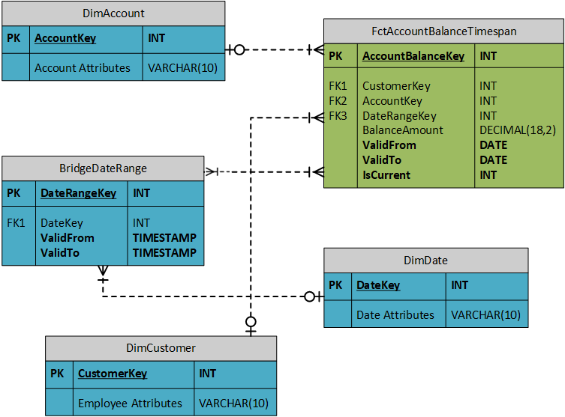
Alternative Approach
Timespan Fact Table: Logical Data Model

Slide 10
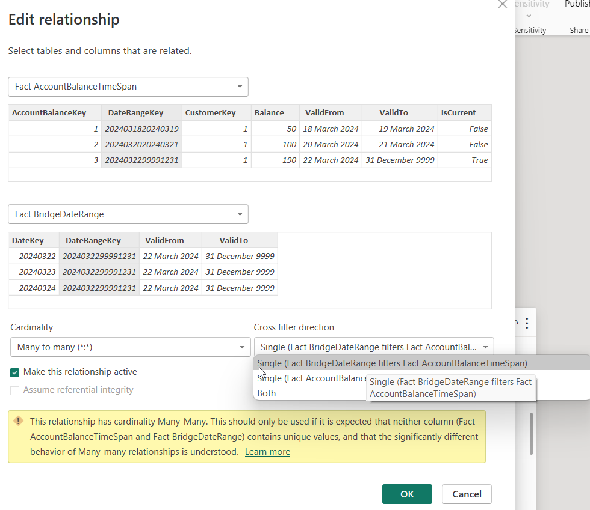
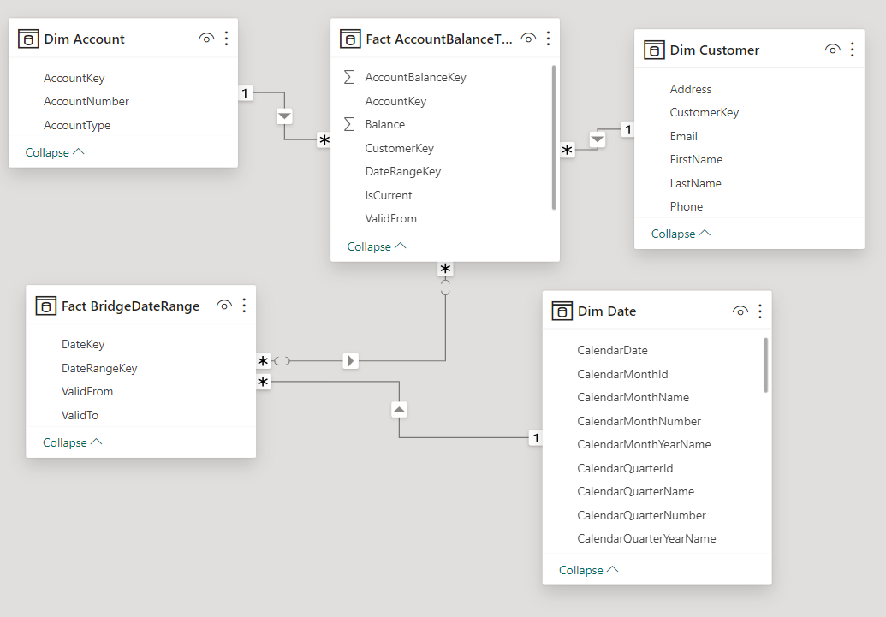
Alternative Approach
Timespan Fact Table
M:M Relationship
Filter Direction

Slide 11
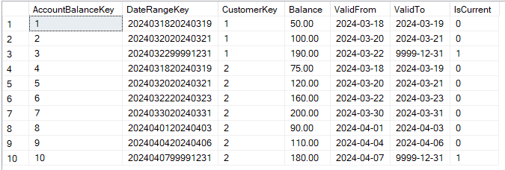

Alternative Approach continued
Timespan Fact Table
Always check the expiry date.
Notes:
Health hazard.

Slide 12
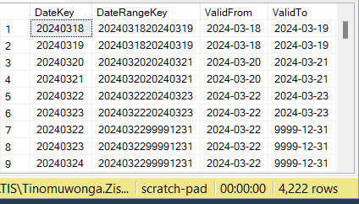
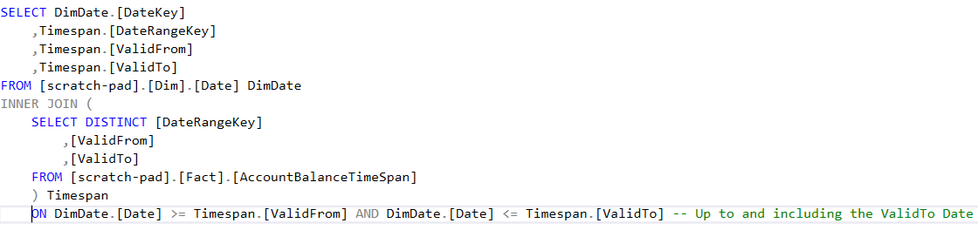
Alternative Approach continued
Timespan Fact Table: Bridge Table
Timespan Fact Table: Bridge Table Script
Notes:
>4k rows (but bridge table is only 4 columns)
So long as valid from and to don’t overlap

Slide 13
Demo
Timespan Fact table worked example

Slide 14
Closing remarks
Benefits of Timespan Fact Table
Single Fact Table
Simple Orchestration
Reporting flexibility
Drawbacks of Timespan Fact Table
Longer ETL
Many: many join
Notes:
Benefits:
One fact table is required, whereas periodic Snapshot is at least 2 (transactional fact table and the period Snapshot fact table)
Simple Orchestration - No need to build a snapshot scheduler; therefore, Orchestration is more straightforward than a periodic snapshot.
Reporting flexibility - The benefit of daily Snapshots without snapshotting every day gives the BI team tremendous flexibility without the storage demands necessitated by daily snapshots
Drawbacks
Longer ETL, especially as data grows over time. Periodic Snapshot is just an insert, whereas Timespan requires a lookup before an insert. You will need to consider your ETL window.
Many: many join between the bridge table and the timespan fact table. As previously stated, this is unavoidable; however, it should be harmless if the filter directions have been set up correctly.

Slide 15
Thank you
Scan QR Code for feedback
Notes:
Credit Davide Mauri
Chapter 8: The Data Warehouse Toolkit: The Definitive Guide to Dimensional Modeling (Timespan Fact Tables)

